Slide 1
Characteristics of a Great Relational Database
Louis Davidson (louis@drsql.org)
Data Architect

Slide 2
How to Recognize when your Relational Database is “good Enough”
Louis Davidson (louis@drsql.org)
Data Architect

Slide 3
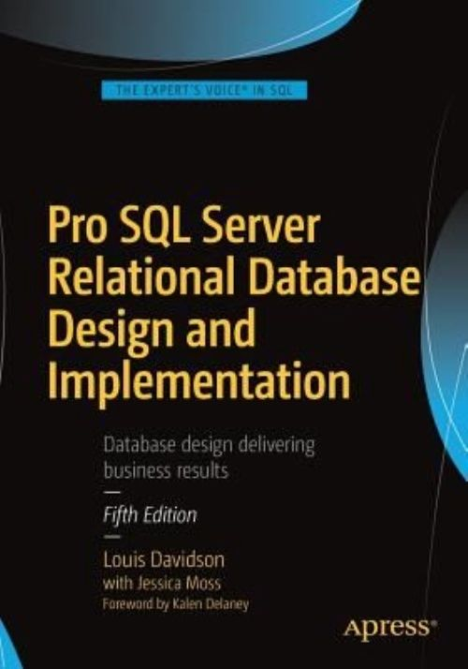
Who am I to tell what is good enough?
Been in IT for over 20 years
Microsoft SQL MVP For 14 Cycles
Corporate Data Architect
Written five books on database design
Ok, so they were all versions of the same book. They at least had slightly different titles each time
They cover some of the same material…in a bit more depth than I can manage today!

Slide 4


The two reasons we build databases
This Photo by Unknown Author is licensed under CC BY

Slide 5
Better is the Enemy of “Good Enough”
How the heck do you measure “good enough”?
Who decides what “good enough” is?
Do you think that the people who say stuff like this generally know or care about anything other than done?
In this next hour, we will seek to what makes a relational DB “good enough”
This is equivalent, to me, to great (because it does what its supposed to do!)

Slide 6

Number 1
Notes:
If your users have started writing down data on notepads BEFORE they enter it into the database…

Slide 7

Or in other words…
IT
JUST
WORKS!
http://www.flickr.com/photos/rnphotos/4689893987/sizes/m/in/photostream/

Slide 8


Number 2
Please bring me one of these
This is a fine whatever, but not what I want
I would like an…

Slide 9
The system actually does what the user needs
Understand the user’s requirements before you code (or at least before you ship)
It is almost impossible to end up with perfection, but the final product ought to do what the user asked for
One way or another…
Attempt greatness, not mediocrity. Best to fall short of greatness than mediocrity.

Slide 10
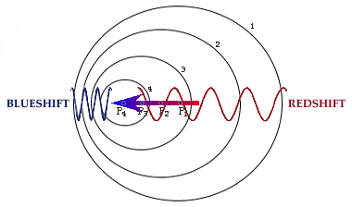
Number 3

Slide 11
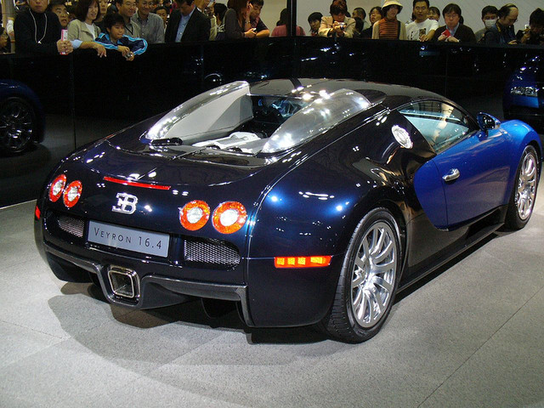
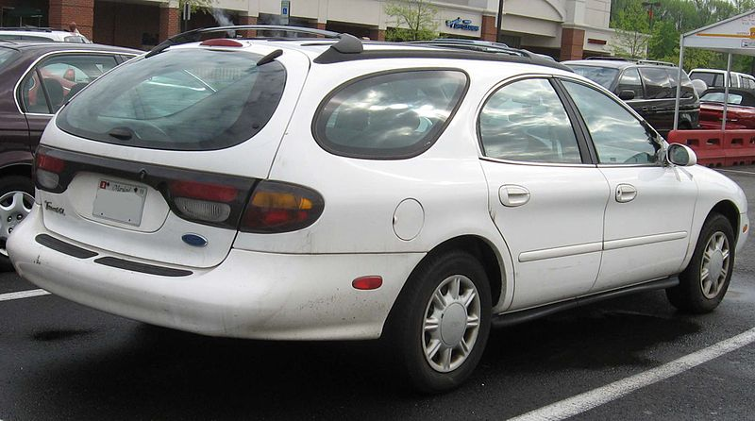
Characteristic - Well Performing
Well performing requires it to perform well everywhere necessary
For example, which car would win in a race?
http://www.flickr.com/photos/mtsn/243344705

Slide 12

Family of four with luggage to the beach race?

Slide 13

Just the First Step
Well performing requires it to work everywhere in every manner necessary
http://www.codinghorror.com/blog/2007/03/the-works-on-my-machine-certification-program.html

Slide 14
My Design Process/Philosophy
The process
First – Design for the requirements with no consideration for performance
Second – Implement the design, with limited consideration for performance
Third – Test, with slightly more consideration for performance
Fourth – Load/Performance Test, with complete consideration for performance, especially concurrency
A good design that doesn’t look performant may turn out to be perfectly adequate

Slide 15
Well Performing
Indexing
Too Little < Just Right < Too Much
Check sys.dm_index_usage_stats to see if indexes useful
Run LOTS of performance test scenarios
Always test multi-user scenarios
Set based queries
Limit Temp Tables
NOT(Cursors) = Good
Sometimes unavoidable, use proper type
Avoid overmodularization
User Defined Functions can kill performance (Will change somewhat in 2019)
View Layering

Slide 16
Well Performing, Even more
Watch queries for proper seeks/scans
Use sys.dm_io_virtual_file_stats to understand your file performance
Unique Rows, Scalar Column Values
(First Normal Form)
Reduce the number of queries (to 0) that use partial column values
Proper handling of concurrency/locks/latches
Without sacrificing “IT WORKS” (NOLOCK, Blech)

Slide 17

Number 4
http://www.flickr.com/photos/brotherxii/3159459278/

Slide 18
Normalization
A process to shape and constrain your design to work with a relational engine
Specified as a series of forms that signify compliance
A definitely non-linear process.
Used as a set of standards to think of compare to along the way
After practice, normalization is mostly done instinctively
Written down common sense!

Slide 19
Normalized - Briefly
Columns - One column, one value
Table/row uniqueness – Tables have independent meaning, rows are distinct from one another.
Proper relationships between columns – Columns either are a key or describe something about the row identified by the key.
Scrutinize dependencies
Make sure relationships between three values or tables are correct.
Reduce all relationships to be between two tables if possible

Slide 20
Normal – How Normal?
Myth:
3rd Normal Form is enough, and more than that makes your database application run slower
Reality
Properly normalized databases are usually faster to work with overall
Most 3rd Normal Form databases are likely in 5th already!
Normalization is more about requirements than anything else
Goal
Users have exactly the number of places to put data into the system that they need.

Slide 21
Normalization Example 1
Requirement: Allow the user to store their complete name and possible aliases
First Name Last Name
Louis
Davidson
Aliases
Lewis; Dr SQL; Dr Squirrel; Louman; SQL Guy; Hey You!

Slide 22
Normalization Example 1
Marketer thinks “Let’s put out a personal sounding note. There is this alias column that seems filled with casual names for people in my sample.” So they set up a mail merge on this document:
Dear <Aliases>
We hope this letter finds you well, I hope that you, <Aliases> will be able to attend our conference.
Sincerely,
A Person Who Thinks They Pay Attention

Slide 23
Normalization Example 1
And the inevitable occurs:
Dear Lewis; Dr SQL; Dr Squirrel; Louman; SQL Guy; Hey You!
We hope this letter finds you well, I hope that you, Lewis; Dr SQL; Dr Squirrel; Louman; SQL Guy; Hey You! will be able to attend our conference.
Sincerely,
Clearly Not A Person Who Pays Attention

Slide 24
Side trip…
The alternate happens too. I got a very similar email to this, but they didn’t have my name:
Dear Dr Default Value,
We hope this letter finds you well, I hope that you, Dr Default Value would be able to speak at our conference.
Sincerely,
Clearly Not A Person Who Pays Attention

Slide 25
Normalization Example 2
Requirement: Table of school mascots
To truly be in the spirit of 1NF, some manner of uniqueness constraint needs to be on a column that has meaning
It is a good idea to unit test your structures by putting in data that looks really wrong and see if it stops you, warns you, or something!
MascotId Name =========== ----------- 1 Smokey 112 Smokey 4567 Smokey 979796 Smokey
Color -----------
Brown Black/White Smoky Brown
School -----------
UT Central High Less Central High Southwest Middle
~~~~~~~~~~~ ~~~~~~~~~~~
<-- Go Vols!

Slide 26
Normalization Example 2
Requirement: Store information about books
What is wrong with this table?
Lots of books have > 1 Author.
What are common way users would “solve” the problem?
Any way they think of!
What’s a common programmer way to fix this?
BookISBN BookTitle BookPublisher Author
=========== ------------- --------------- -----------
111111111 Normalization Apress Louis 222222222 T-SQL Apress Michael 333333333 Indexing Microsoft Kim 444444444 DMV Book Simple Talk Tim
, Louis
& Louis
and Louis
444444444-1 DMV Book Simple Talk Louis

Slide 27
Normalization Example 2
Add a repeating group?
BookISBN BookTitle BookPublisher …
=========== ------------- ---------------
111111111 Normalization Apress … 222222222 T-SQL Apress … 333333333 Indexing Microsoft … 444444444 DMV Book Simple Talk …
Author1 Author2 Author3
----------- ----------- -----------
Louis Michael Kim Tim Louis

Slide 28
It starts out innocent enough
Email1 Email2 Email3
--------- --------- -----------
Email1Status Email1Type Email1PrivateFlag
------------ ------------ -------------------
Email2Status Email2Type Email2PrivateFlag
------------ ------------ -------------------
Email3Status Email3Type Email3PrivateFlag
------------ ------------ -------------------

Slide 29
Normalization Example 2
The right way… repeating groups become tables!
And it gives you easy expansion
BookISBN BookTitle BookPublisher
=========== ------------- ---------------
111111111 Normalization Apress 222222222 T-SQL Apress
333333333 Indexing Microsoft 444444444 DMV Book Simple Talk
BookISBN Author
=========== =============
111111111 Louis 222222222 Michael 333333333 Kim 444444444 Tim
ContributionType
----------------
Principal Author
Principal Author
Principal Author
Co-Author
Co-Author
444444444 Louis

Slide 30
Normalization Example 3
Requirement: Driver registration for rental car company
Column Dependencies
Vehicle Owned, check
Height and EyeColor, check
WheelCount, <buzz>, driver’s do not have wheelcounts
Driver Vehicle Owned Height EyeColor WheelCount
======== ---------------- ------- --------- ----------
Louis Hatchback 6’0” Blue 4
Ted Coupe 5’8” Brown 4
Rob Tractor trailer 6’8” NULL 18

Slide 31
Normalization Example 3
Two tables, one for driver, one for type of vehicles and their characteristics
Driver Vehicle Owned (FK) Height EyeColor
======== ------------------- ------- ---------
Louis Hatchback 6’0” Blue
Ted Coupe 5’8” Brown
Rob Tractor trailer 6’8” NULL
Vehicle Owned WheelCount
================ -----------
Hatchback 4
Coupe 4
Tractor trailer 18

Slide 32
Normalization Example 4
Requirement: Store users and their names
How would you search for someone with a last name of Niesen? David?
What if the name were more realistic with Suffix, Prefix, Middle names?
UserId UserName PersonName
=========== ~~~~~~~~~~~~~~ ---------------
1 Drsql Louis Davidson
2 Kekline Kevin Kline
3 Datachix2 Audrey Hammonds 4 PaulNielsen Paul Nielsen

Slide 33
Normalization Example 4
Break the person’s name into individual parts
This optimizes the most common search operations
It isn’t a “sin” to do partial searches on occasion:
Like if you know the last name ended in “son”
If you also need the full name, let the engine manage this using a calculated column:
PersonFullName as Coalesce(PersonFirstName + ' ') + Coalesce(PersonLastName)
UserId UserName PersonFirstName PersonLastName
=========== ~~~~~~~~~~~~~~ --------------- --------------
1 Drsql Louis Davidson
2 Kekline Kevin Kline
3 Datachix2 Audrey Hammonds 4 PaulNielsen Paul Nielsen

Slide 34
Normalization Example 5
Requirement: define the classes offered with teacher and book
Dependencies
Class determines Trainer (Based on qualification)
Class determines Book (Based on applicability)
Trainer does not determine Book (or vice versa)
If trainer and book are related (like if teachers had their own specific text,) then this table is fine
Trainer Class Book
========== ============== ================================
Louis Normalization DB Design & Implementation
Chuck Normalization DB Design & Implementation
Fred Implementation DB Design & Implementation
Fred Golf Topics for the Non-Technical

Slide 35
Normalization Example 5
Trainer Class Book
========== ============== ================================
Louis Normalization DB Design & Implementation
Chuck Normalization DB Design & Implementation
Fred Implementation DB Design & Implementation
Fred Golf Topics for the Non-Technical
Question: What classes do we have available and what books do they use?
SELECT DISTINCT Class, Book FROM TrainerClassBook
Class Book
=============== ==========================
Normalization DB Design & Implementation
Implementation DB Design & Implementation
Golf Topics for the Non-Technical
Doing a very slow operation, sorting your data, please wait

Slide 36
Normalization Example 5
Break Trainer and Book into independent relationship tables to Class
Class Trainer
=============== =================
Normalization Louis
Normalization Chuck
Implementation Fred
Golf Fred
Class Book
=============== ==========================
Normalization DB Design & Implementation
Implementation DB Design & Implementation
Golf Topics for the Non-Technical

Slide 37
Why Normal?
Enhance Data Integrity
Parsing data is messy
Duplicated data often gets out of sync
Give the engine the data in a format it wants
Indexes, statistics, etc all work on scalar values
Eliminating Duplicated Data
Disk is still the most expensive operation
Avoiding Unnecessary Data Tier Coding
If this is where the performance bottleneck is, then this should be a no-brainer, right?

Slide 38
Consider the Requirements
Almost every value could be broken down more
Consider a document. It could be stored either as rows of:
Complete documents
Chapters/Sections
Paragraphs
Sentences
Words
Characters
Bits
The right way is determined by the actual need
Normalization is a practical task, not an academic one.
When users have the right number of places to put data, no more, no less, you have it right

Slide 39

Number 5

Slide 40
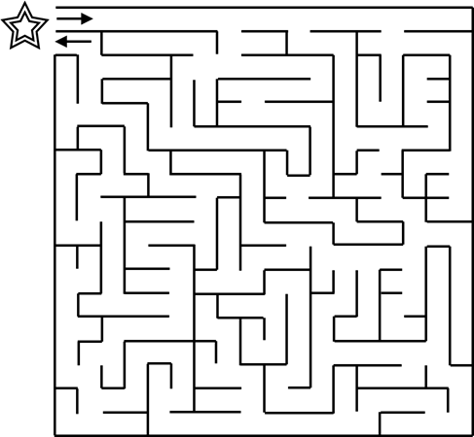
Mazes and Puzzles are fun diversions…

Slide 41
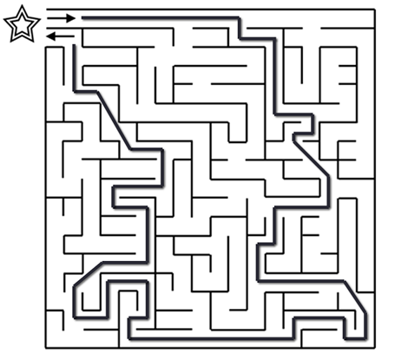
…not a design goal
An incoherent design/implementation is far more difficult to solve than a maze
Mazes have been worked out so there is one and only one solution
The consumers of the data shouldn’t have to run a maze to find the data they need
Data should empower the users

Slide 42
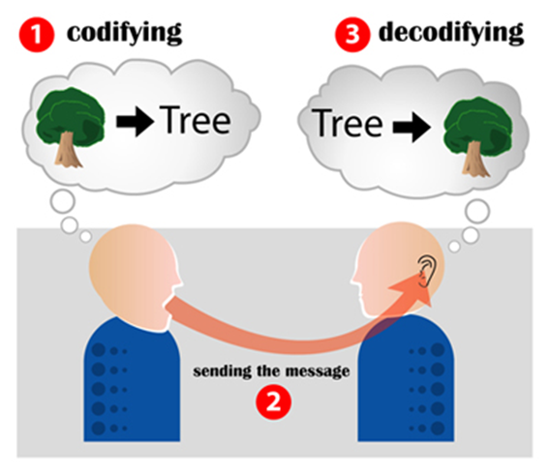
Coherent
Users who see your schema should immediately have a good idea of what they are seeing.
Proper Normalization goes a long way towards this goal
Develop and follow a (not eight) human readable standard
The worst standard available is better than 10 well thought out standards being implemented simultaneously
http://en.wikipedia.org/wiki/File:Encoding_communication.jpg

Slide 43
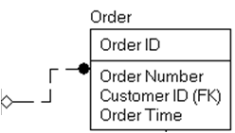
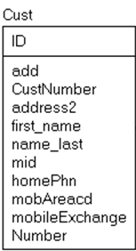
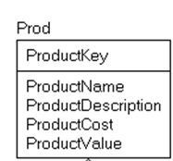
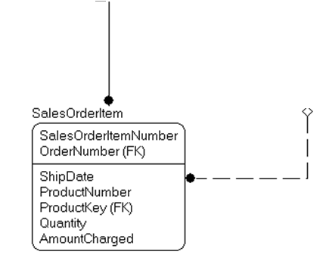
The best of intentions

Slide 44
Names
If you must abbreviate, use a data dictionary to make sure abbreviations are always the same
Names should be as specific as possible
Data should rarely be represented in the column name
Tables
Singular or Plural (either one)
I prefer singular, but for heaven’s sake, stick with one!
Columns
Singular - Since columns should represent a scalar value
A good practice to get common look and feel is to use a “class” word as the name or suffix that gives general idea of the type/usage of the column

Slide 45
Column Names – Class Word Examples
Name is a textual string that names the row value, but whether or not it is a varchar(30) or nvarchar(128) is immaterial (Example Company.Name)
UserName is a more specific use of the name classword that indicates it isn’t a generic usage
EndDate is the date when something ends. Does not include a time part
SaveTime is the point in time when the row was saved
PledgeAmount is an amount of money (using a numeric(12,2), or money, or any sort of types)
PledgeAmountEuros is an amount of money (using a numeric(12,2), or money, or any sort of types) in Euros
DistributionDescription is a textual string that is used to describe how funds are distributed
TickerCode is a short textual string used to identify a ticker row
EndedFlag a column that is ether TRUE/FALSE; 0/1; YES/NO indicated something has ended

Slide 46
Coherency Goals
Good - Databases are at least designed by individuals that have some idea of what they are doing
Great - Individual databases feel like they were created by one architect level person
Perfection - All databases in the enterprise look and feel like they were all created by the same qualified person

Slide 47

Mrphpph, grrrrm rppspppth…

Slide 48
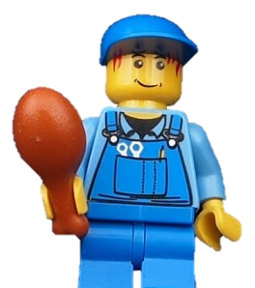
We are a vendor and don’t want to share out schema… so we obfuscate it to make sure our competitors can’t see it.
This makes things incoherent for our users. What should we do?
Sorry.

Slide 49

Number 6

Slide 50

Ideally, your ETL Developer doesn’t look like this after adding some new data from your “master” system

Slide 51
Fundamentally sound
The goal is that data inserted into your databases remain correct
No matter what the user does, they cannot negatively affect:
Foreign keys
Column domains
Processing
Can’t prevent users from making all mistakes

Slide 52
Typical Systems
user process
extract transform cleaning
(perhaps integrate with other systems)
dw
data
cleaning
oltp data
user process
user process
cleaning
cleaning
cleaning
user process
cleaning
cleaning
user process
user process
user process

Slide 53
The goal
user process
dw
data
extract transform (Perhaps integrate with other systems)
oltp data
user process
user process
user process
user process
user process
user process
HOW do you do this? I don’t completely care… But I have plenty of suggestions!

Slide 54

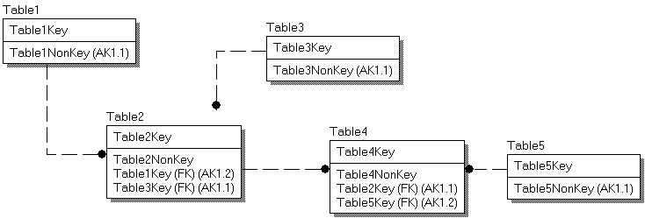
Don’t just model relationships…
How your database looks without constraints
With FOREIGN KEY, UNIQUE, and CHECK constraints
Provides documentation for users to understand your structures without needing the model
(More important) Provides useful guidance to the relational engine to understand expected usage patterns
Ok, so you can’t see the check constraints in the model, but the optimizer knows they are there

Slide 55
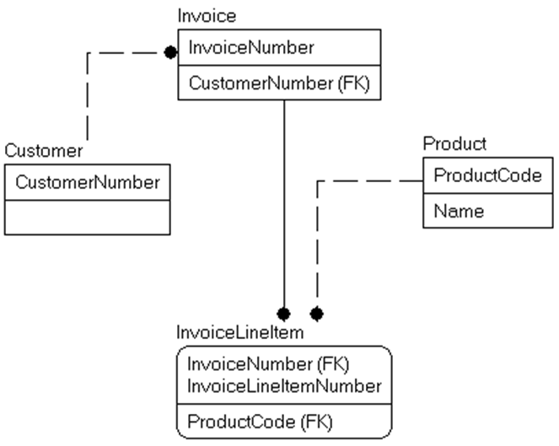
The Constraint Guarantee - FK
With “trusted” constraints, the following queries are guaranteed to return the same value
SELECT count(*) FROM InvoiceLineItem
SELECT count(*) FROM InvoiceLineItem JOIN Invoice ON Invoice.InvoiceNumber = InvoiceLineItem.InvoiceNumber

Slide 56
Check for trusted/disabled keys
SELECT OBJECT_SCHEMA_NAME(parent_object_id) AS schemaName, OBJECT_NAME(parent_object_id) AS tableName,
NAME AS constraintName,
Type_desc, is_disabled, is_not_trusted
FROM sys.foreign_keys
UNION ALL
SELECT OBJECT_SCHEMA_NAME(parent_object_id) AS schemaName, OBJECT_NAME(parent_object_id) AS tableName,
NAME AS constraintName,
Type_desc, is_disabled, is_not_trusted
FROM sys.check_constraints

Slide 57
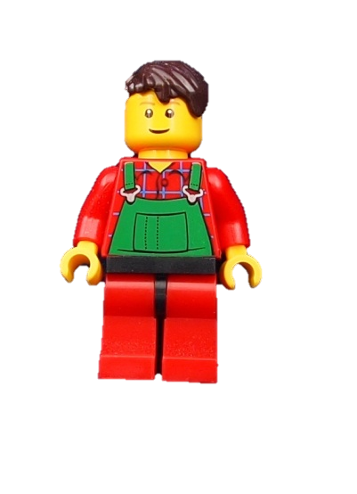
We tried using constraints, but we kept getting errors, so we started using UI code to check data instead.
We keep getting data issues though. Why?

Slide 58

Number 7

Slide 59

Documented
What is this?
Coffee Cup
What is this USED for?
Coffee cup?
Pencil holder?
Change Jar?
Sample Transporting Vessel?
If you are questioning whether or not to document the purpose of this cup, if this is used to hold coffee for anyone in your office, no problem.

Slide 60
Non-standard usage
Would everyone know what “potable” means?
Caution
Not
Potable!
Louis’
Coffee
Pencils

Slide 61
Documentation should not be open to far too many interpretations
SPEED LIMIT
ENFORCED BY
AIRCRAFT

Slide 62
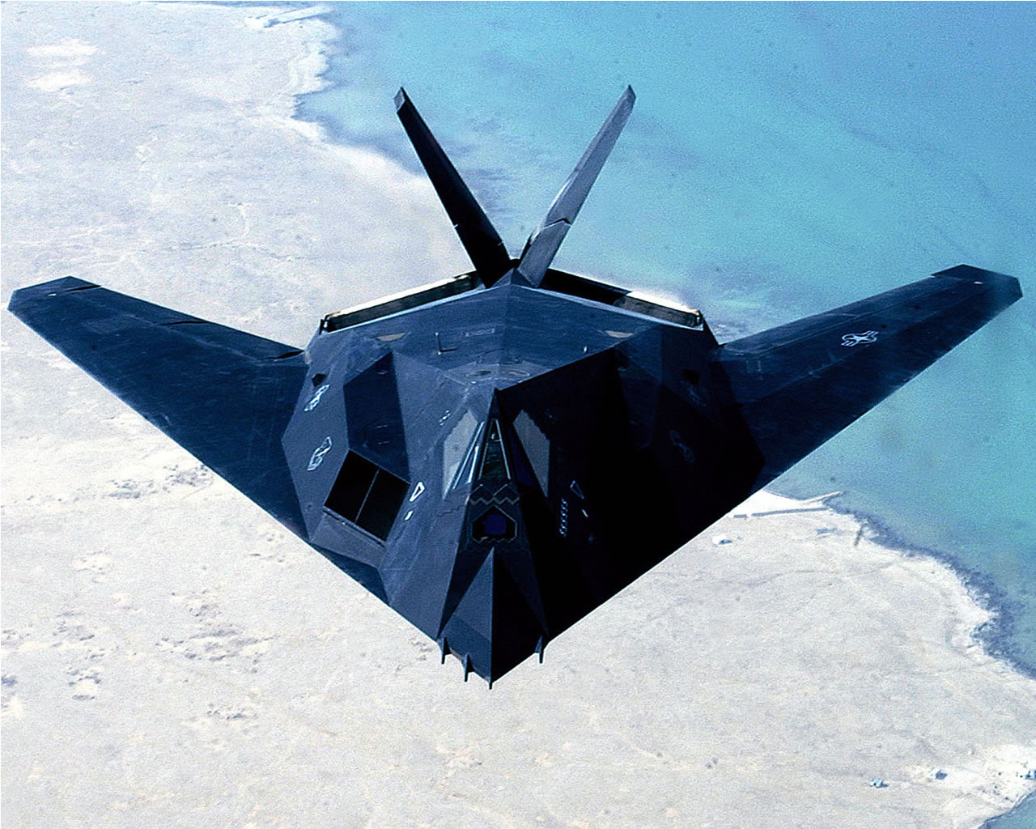
Documentation should not be open to far too many interpretations
This Photo by Unknown Author is licensed under CC BY-SA-NC

Slide 63
Documentation should not be open to far too many interpretations
SPEED MONITORING DONE FROM AIRCRAFT

Slide 64
Documentation
Like the coffee cup example, document all cases that aren’t intuitively obvious to the lowest common denominator
Every table and column should have a succinct definition describing it’s purpose
Make full use of the extended properties to get the documentation available contextually
Don’t bury your constituents in documentation generated from code scrapers
Not that they are necessarily bad, but good documentation requires a distinctively “human” approach
KEY WORD: Succinct!

Slide 65

If I document everything so well, can’t they fire me first?

Slide 66

Number 8

Slide 67

Secure
“Today you can go to a gas station and find the cash register open and the toilets locked. They must think toilet paper is worth more than money.” —Joey Bishop
http://www.flickr.com/photos/freefoto/5692512457/

Slide 68
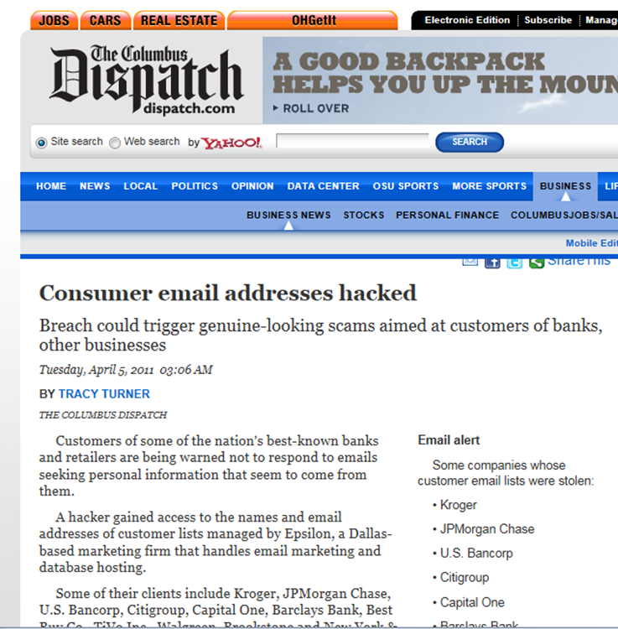
Secure – Don’t be a headline

Slide 69
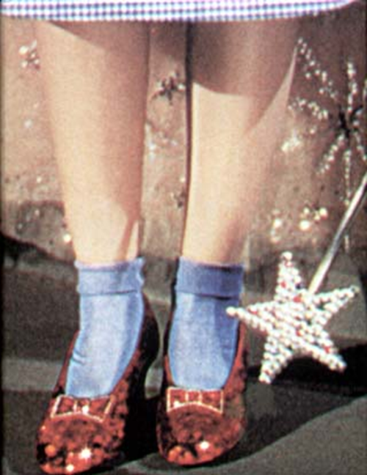
Dorothy and the Red Shoes
She had the power all along, she just didn’t know it.
If some users were just a bit more curious about what they could do…they might just be amazed…

Slide 70
Secure
Secure the server first – Keeping hackers away from your server/backups keeps them away from your server/backups
Grant rights to roles rather than users – It is easier, and less likely that users get elevated security for long periods of time
Grant blanket security no higher than the schema – Use db_reader/db_writer in only in rare situations
Don’t overuse the impersonation features: EXECUTE AS is a blessing, and it opens up a world of possibilities. It does, however, have a darker side

Slide 71
Security Continued
Encrypt sensitive data: SQL Server has several means of encrypting data, and there are other methods available to do it off of the SQL Server box.
Encryption is like indexes. Use as much as you need to, but not less.
Most organizations do most security in client code (often based on tables that they build in the application.)
Ideally minimally using the database_principal identity as the basis for identification.

Slide 72

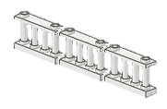


Security – Continued (even more)
Keep permissions to the minimum necessary, even for the application
If the fence is up and the gate is closed and locked, sheep can’t just wander away
If the application requires DBO rights, it should be considered the first place to blame when something goes wrong
Yay! DBAaaah..
Our hero!
Boo!
Baa?
Yum

Slide 73
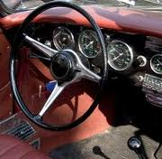
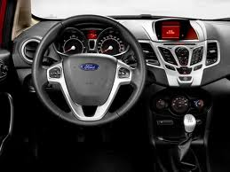
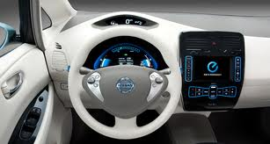
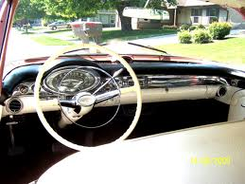
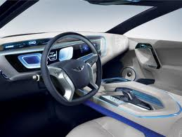
Number 9

Slide 74
Encapsulated
Eliminate Hints
Codd’s goal was separation of implementation and usage
Early database implementations required you to know the paths to data, names of indexes, etc
Hints revert to this mode of thinking
Use them as sparingly as possible
Review hint usage every CU, SP, and/or Major Release
UI <> Table structure
Design:
Database for the data
UI for the user
Everything in between is there to optimize the relationship
UI is reasonably easy to change, data structures with state are not.

Slide 75
Encapsulated – Continued
Layered approach
Ideally, there are layers of malleable code between the data structures and the UI
Stored procedures (note, duck here) are a good candidate for a layer
They are best for parameterization of queries
They should be used as replacements for queries, and some processes that require intermediate data storage
They should NOT be used as replacements for large blocks of code.
T-SQL is awesome for retrieving and manipulating data
T-SQL is pretty awful at iterating though rows one-by-one
Data driven design
Data should be accessed in one way, by knowing the table finding a row by it’s key and getting the column.
You should not have to choose a column programmatically
Adding similar data should not require modification of code (adding functionality should)

Slide 76

Number 10

Slide 77
Traceable
Any data that is related should be related
ScheduledPayment
ScheduledPaymentId (PK)
ChargeDayOfMonth
PaymentMethod
ScheduledPaymentItem
ScheduledPaymentItemId ((PK)
PaymentPurpose
Amount
ScheduledPaymentId (FK)
Payment
PaymentId (PK)
ChargeDate
PaymentMethod
Payment Item
PaymentItemId (PK)
PaymentPurpose
Amount
PaymentId (FK)

Slide 78
Traceable
So you add a foreign key… but to where?
ScheduledPayment
ScheduledPaymentId (PK)
ChargeDayOfMonth
PaymentMethod
ScheduledPaymentItem
ScheduledPaymentItemId ((PK)
PaymentPurpose
Amount
ScheduledPaymentId (FK)
Payment
PaymentId (PK)
ChargeDate
PaymentMethod
ScheduledPaymentId (FK)
Payment Item
PaymentItemId (PK)
PaymentPurpose
Amount
PaymentId (FK)

Slide 79
Traceable
You should be able to trace to the lowest item
ScheduledPayment
ScheduledPaymentId (PK)
ChargeDayOfMonth
PaymentMethod
ScheduledPaymentItem
ScheduledPaymentItemId ((PK)
PaymentPurpose
Amount
ScheduledPaymentId (FK)
Payment
PaymentId (PK)
ChargeDate
PaymentMethod
ScheduledPaymentId (FK)
Payment Item
PaymentItemId (PK)
PaymentPurpose
Amount
PaymentId (FK)
ScheduledPaymentItemId(FK)

Slide 80
Traceable
Eliminate redundant relationships too. Now you can see the item that created the payment
ScheduledPayment
ScheduledPaymentId (PK)
ChargeDayOfMonth
PaymentMethod
ScheduledPaymentItem
ScheduledPaymentItemId ((PK)
PaymentPurpose
Amount
ScheduledPaymentId (FK)
Payment
PaymentId (PK)
ChargeDate
PaymentMethod
Payment Item
PaymentItemId (PK)
PaymentPurpose
Amount
PaymentId (FK)
ScheduledPaymentItemId(FK)

Slide 81
Traceable
But what if the user changes the details of the scheduled payment?
ScheduledPayment
ScheduledPaymentId (PK)
ChargeDayOfMonth
PaymentMethod
ScheduledPaymentItem
ScheduledPaymentItemId ((PK)
PaymentPurpose
Amount
ScheduledPaymentId (FK)
Payment
PaymentId (PK)
ChargeDate
PaymentMethod
Payment Item
PaymentItemId (PK)
PaymentPurpose
Amount
PaymentId (FK)
ScheduledPaymentItemId(FK)

Slide 82
Traceable
The point here is that
We store data to make things happen
Report on what happened and why
Understanding why a user was charged 300 when they expected to be charged 30 is important.
Changing data that makes more can be dangerous. Consider versions of data to tell the entire story

Slide 83
Recap – Great Databases are…
Correct – And all that that entails
Well Performing – Gives you answers fast
Normal – normalized as much as necessary/possible based on the requirements
Coherent –comprehendible, standards based, names/datatypes all make sense, needs little documentation
Fundamentally Sound – fundamental rules enforced such that when you use the data, you don’t have to check datatypes, base domains, relationships, etc
Documented – Anything that cannot be gather from the names and structures is written down and/or diagrammed for others
Secure – Users can only see data they are privy to
Encapsulated – Changes to the structures cause only changes to usage where a table/column directly accessed it
Traceable – Data that makes data tells the entire story, and keeps up history

Slide 84
Reality
This is not about job security for a bunch of architects
When the tool is created that creates a database that is
Normalized
Well named
Understandable
Coherent
Documented
Secure
Well performing
and it no longer needs a data architect/dba to get it right,
I hope I saw it coming and was part of the team creating the tools!

Slide 85
Contact info
Louis Davidson - louis@drsql.org
Website – http://drsql.org ← Get all of my slides here
Twitter – http://twitter.com/drsql
Simple Talk Blog http://www.simple-talk.com/community/blogs/drsql/default.aspx
Notes:
[twitter] Slides will be on drsql.org in the presentations area for this and the keynote as soon as I can get them out there. @rmtechtrifecta [/twitter]

Slide 86
Questions?

Slide 87
Thank You for Attending

